Slide 1


FIFTEENTH ANNUAL COMPETITION LAW, ECONOMICS & POLICY CONFERENCE
Constitutionalism and access to healthcare
(right to healthcare).
Arnold A Okanga

Slide 2

Outline of presentation
A presentation by Tembeka Nicholas Ngcukaitobi (a South African lawyer, public speaker, author and political activist.)
The pharmaceutical industry access to vaccine diagnostic kits and related products during and after the Covid-19 pandemic.
Panel discussion (Moderated by Judge Dennis Davis, panellist included: Fatima Hassan, Dr Clive Ondari, Mr. James Hodge, and Greg Hamond)

Slide 3
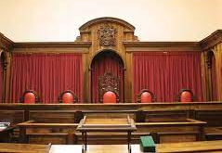
Case Study
The scope of constitutional control and regulation of market power as provided for in the constitution regulations and policy ***SA***.

Slide 4

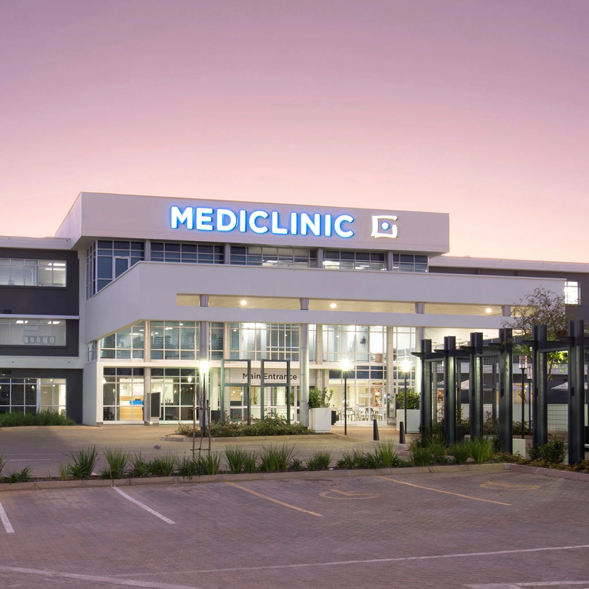


Case Study

Slide 5
Case Study……
29th September 2016 Mediclinic Southern Africa (Pty) Limited (Mediclinic) and Matlosana Medical Health Services (Pty) Limited (Matlosana), notified the Competition Commission of their intended merger.
22nd March 2019, the Tribunal held that the proposed merger would take away the lower tariffs available to uninsured patients at the target hospitals

Slide 6
Case Study…….
Aggrieved by the Tribunal’s decision, the respondents appealed to the Competition Appeal Court. In which, the majority approved the merger with conditions.
Unhappy with the decision of the Competition Appeal Court, the CCSA sought leave to appeal the order and judgement of the Competition Appeal Court to the Constitutional Court.

Slide 7
Case Study……
The Court found that the Appeal Court was not entitled in law to interfere with the Tribunal’s findings.

Slide 8
The pharmaceutical industry access to vaccine diagnostic kits and related products during and after the Covid-19 pandemic.
Excessive pricing and where the responsibility lies
Role of competition law in regard to access of medicines and health services
Relationship between Intellectual Property Rights and Competition Law
The role of constitution in general

Slide 9
Fatima Hassan (Health Justice Initiative)
importance of access to vaccine as an enabler of economic recovery.
highlighted the lack of price transparency in the pharmaceutical industry.

Slide 10
Dr Clive Ondari (World Health Organization)
highlighted areas of work of WHO that try to even the ground for vaccine manufacturers distributions and rational use of medicines
difficulties observed in implementing anti-price gauging laws
challenges which they were taking up was the localisation of pharmaceutical manufacturing,

Slide 11
Mr. James Hodge of CCSA
IP-law, constitution law and the competition Act
IP Law in essences grants the right not to use a particular invention product
there are many competing innovations and many competing innovative products
biggest problem in healthcare is an inelastic demand and the ability to price at almost exorbitant levels

Slide 12
Mr. Greg Harman (Berkeley Research Group LLC)
a focus on pricing of vaccines from a big Pharmaceutical perspective, the ability of companies to use their dominant power to price excessively in markets where demand is inelastic and when there is insufficient competition.
one can simply not observe that prices are high to conclude that its excessive

Slide 13
Mr. Greg Harman (Berkeley Research Group LLC)
In conclusion from a policy perspective, there is always a tension between the need to regulate prices, which could, if done wrong, lead to chilling of investments,

Slide 14
Summary/takeaways and way forward
The Linkage between Intellectual property rights, the Competition Law and the Constitution where aligned can lead to a yield in affordable drugs since healthcare is a fundamental right within the constitution
There is need to address vaccine and drugs manufacturing base as the capacity to manufacturing as one gets access to voluntary licensing or compulsory licensing had become a critical issues

Slide 15


Feedback: info@cak.go.ke

