Slide 1

COMPETITION LAW AND POLICY- Knowledge Co-Creation Program : CAK Staff Sensitization
Presenter: Feisal Adan

Slide 2
PRESENTATION OUTLINE
Background
The Japanese Anti-monopoly Law
Outline of the Japanese Anti-monopoly Law;
Regulation of mergers ;
Unreasonable restraint of trade (cartel & bid-rigging regulation) Leniency; and
Abuse of Superior Bargaining power
Investigation procedures and administrative measures of JFTC.
Collection and Use of Electronic Evidence.

Slide 3
Background
The Japan International Cooperation Agency (JICA) together with the Japan Fair Trade Commission (JFTC) organized a Two-weeks virtual training course on Competition Law and Enforcement for Competition Agencies.
The course aimed at improving practical skills in competition issues.
Designed primarily for competition authorities.

Slide 4
Japanese Anti-monopoly Law
Outline of the Japanese Anti-monopoly Law
The Antimonopoly Act (AMA) No. 54 of April 14, 1947 mainly covers anti-competitive behavior that is prohibited under the Antimonopoly Act in Japan.
The legal framework of the Antimonopoly Act has two main purposes that is the economic purpose and social purpose.

Slide 5

Japanese Anti-monopoly Law Cont…
Outline of Japanese Anti-monopoly Law
AMA is designed to promote fair and free competition.
Enforcement of the Act (administrative disposition):
Cease and desist order.
Surcharge payment order.

Slide 6
Japanese Anti-monopoly Law Cont…
Regulation of mergers: - mergers, shareholding, business transfers, corporate separation.
It is covered under three classifications:
Horizontal business combination;
Vertical business combination;
Conglomerate business combination.

Slide 7
Outline of the Japanese AMA cont…
The review is based on three key factors:
Delineation of a market;
Substantial restraint on competition; and
Remedies for mergers with substantial restraint of competition.

Slide 8
Outline of the Japanese AMA cont…
Unreasonable restraint of trade
Price-fixing agreements. quantity-limiting agreements, bid rigging among others.
Restrictive agreements- vertical in nature are generally classified as unfair trade practices.).

Slide 9
Outline of the Japanese AMA cont…
Leniency/Immunity
A maximum of five companies will be granted immunity.
The first applicant to come forward before the start of a JFTC investigation is granted full immunity, 2nd is granted a 50% , and the 3rd , 4th and 5th are granted a 30% reduction.

Slide 10
Outline of the Japanese AMA cont…
Abuse of Superior Bargaining power
The elements that constitute ASBP practice are:
Superior bargaining position;
Unjust behaviour in light of normal business practices.
ASBP applies even if a player does not have a dominant position in the market, but abuses its superior bargaining position.

Slide 11
Outline of the Japanese AMA cont…
Abuse of Superior Bargaining power task force within the Investigation Bureau with mandate of conducting investigations established in November 2009.
Triggers:
Public Complaint; and
Market Intelligence.
Detections by JFTC are made through general conversations with market players in order to pick out the issues in the market.

Slide 12

Outline of the Japanese AMA cont…
JFTC ensures confidentiality in the process of carrying out investigations.
There are 5 main remedies in AMA for abuse of superior bargaining power violations namely cease and desist orders, surcharge payments, warnings, caution and termination.

Slide 13
The investigation procedures and administrative measures of JFTC
JFTC obtains information through:
Notifications
Own information collection;
Submission by informants ; and
Request by the Small and Medium Enterprise Agency.

Slide 14
The investigation procedures and administrative measures of JFTC Cont…
Under administrative investigations, JFTC may:
Conduct on-the-spot inspection;
Order violators to submit books, & other materials;
Order suspected violators/witnesses to appear before;
Order expert witnesses to appear to give expert opinions.
JFTC - Criminal investigation authority (2006).

Slide 15
Investigation techniques on digital evidence
Digital Forensics Team (DFT):
Gather evidence needed in Cartel Case investigation;
Gather evidence left in digital devices;
Research the way to handle digital evidence better;
Set standard procedure;
Provide training and support for case investigators.
Seize, preserve and analyze digital evidence during and after dawn raids.

Slide 16
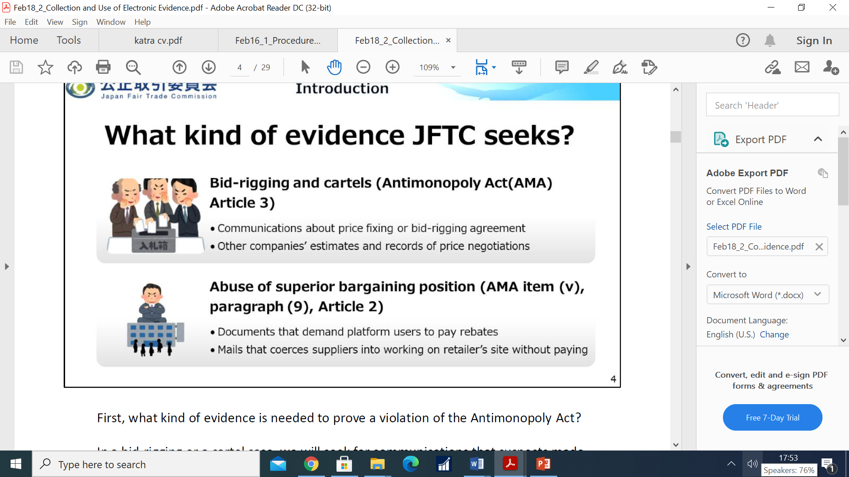
Collection and Use of Electronic Evidence
What kind of evidence JFTC seeks?
                Bid-rigging and cartels (i.e. price fixing, bid-rigging agreement etc).
          Abuse of superior bargaining position (ASBP).
                i.e. Documents that demands platform users to pay rebates.

Slide 17
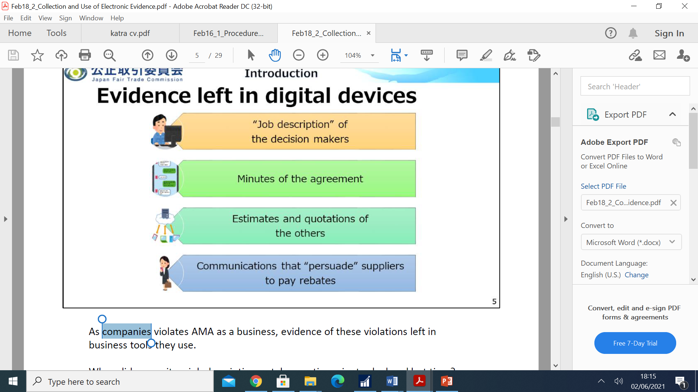
Collection and Use of Electronic Evidence Cont…
Evidence Left in the Digital Devices

Slide 18
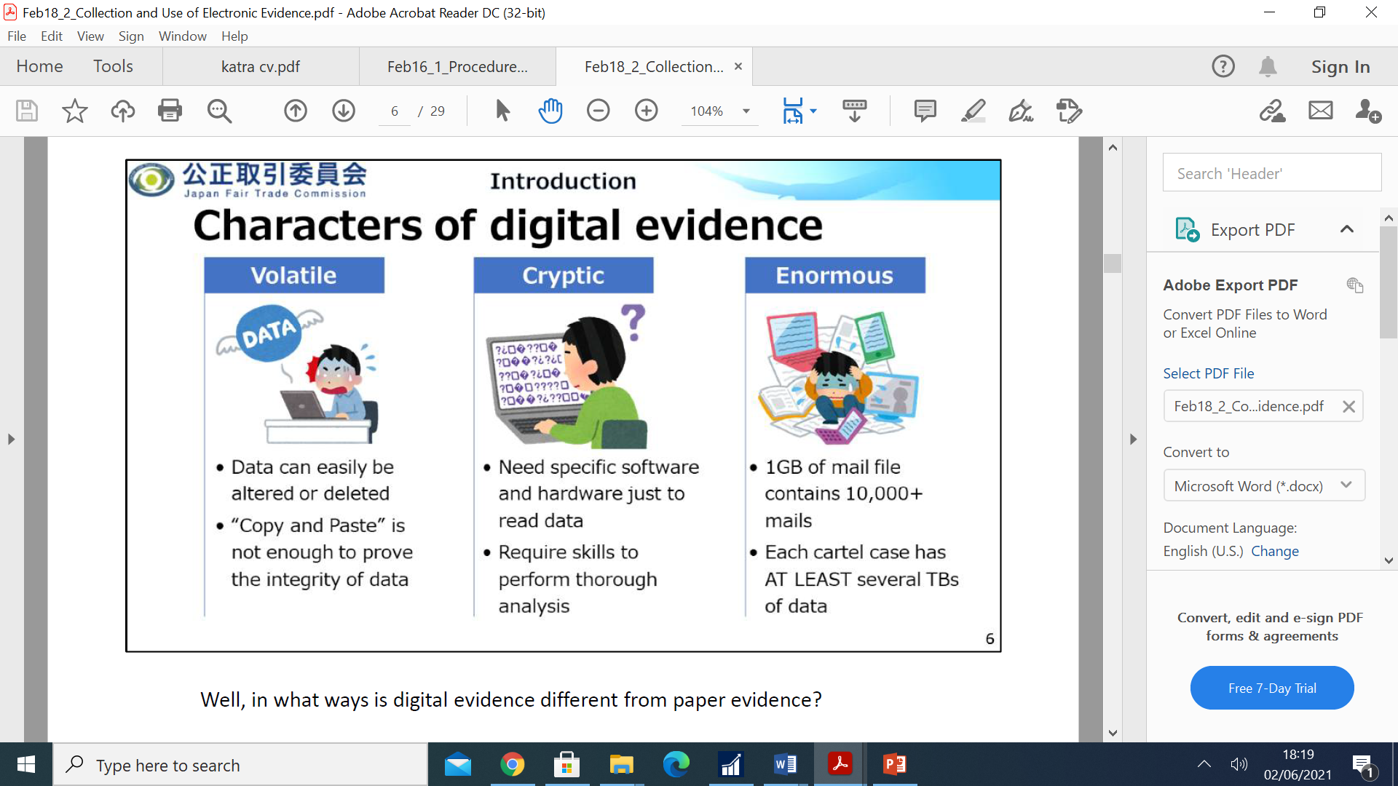
Collection and Use of Electronic Evidence Cont…
Characters of Digital Evidence

Slide 19
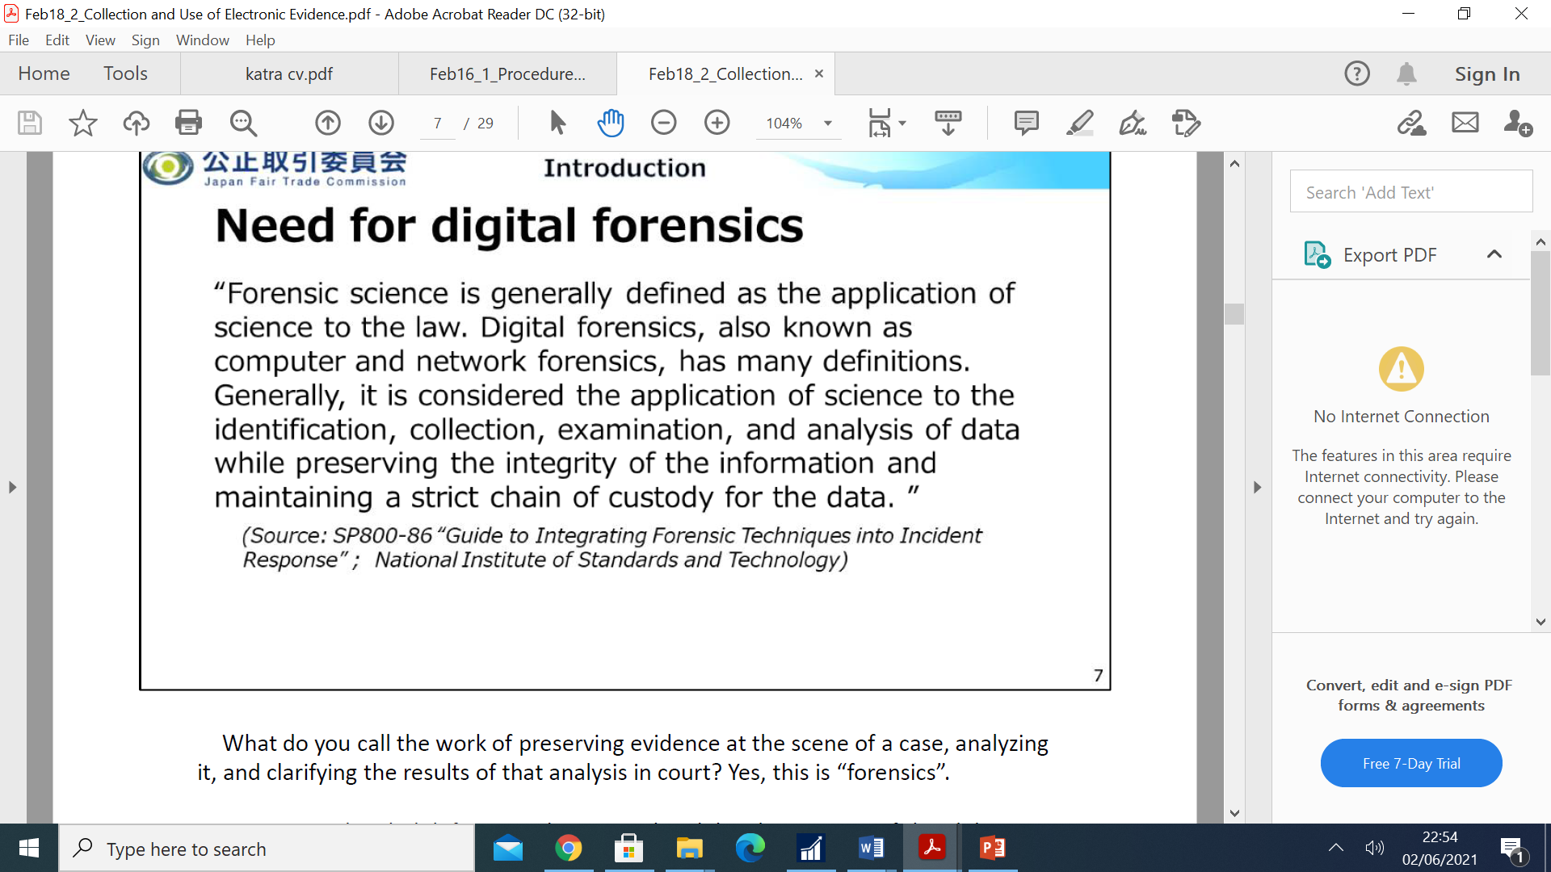
Collection and Use of Electronic Evidence Cont…
Need for digital forensic
“Forensic Science is generally defined as the application of science to the law. Digital forensic, also known as computer and network forensics, has many definitions. Generally, it is considered the application of science to the identification, collection, examination and analysis of data while preserving the integrity of the information and maintaining a strict chain of custody for the data.”

Slide 20
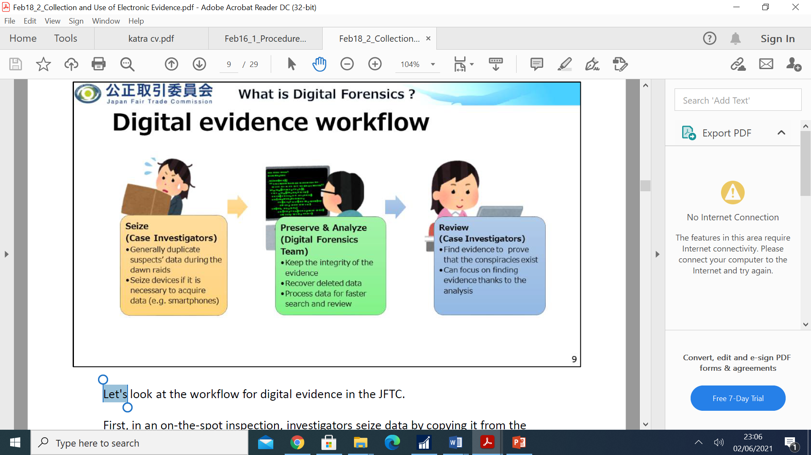
Collection and Use of Electronic Evidence Cont…
Digital Evidence Workflow

Slide 21
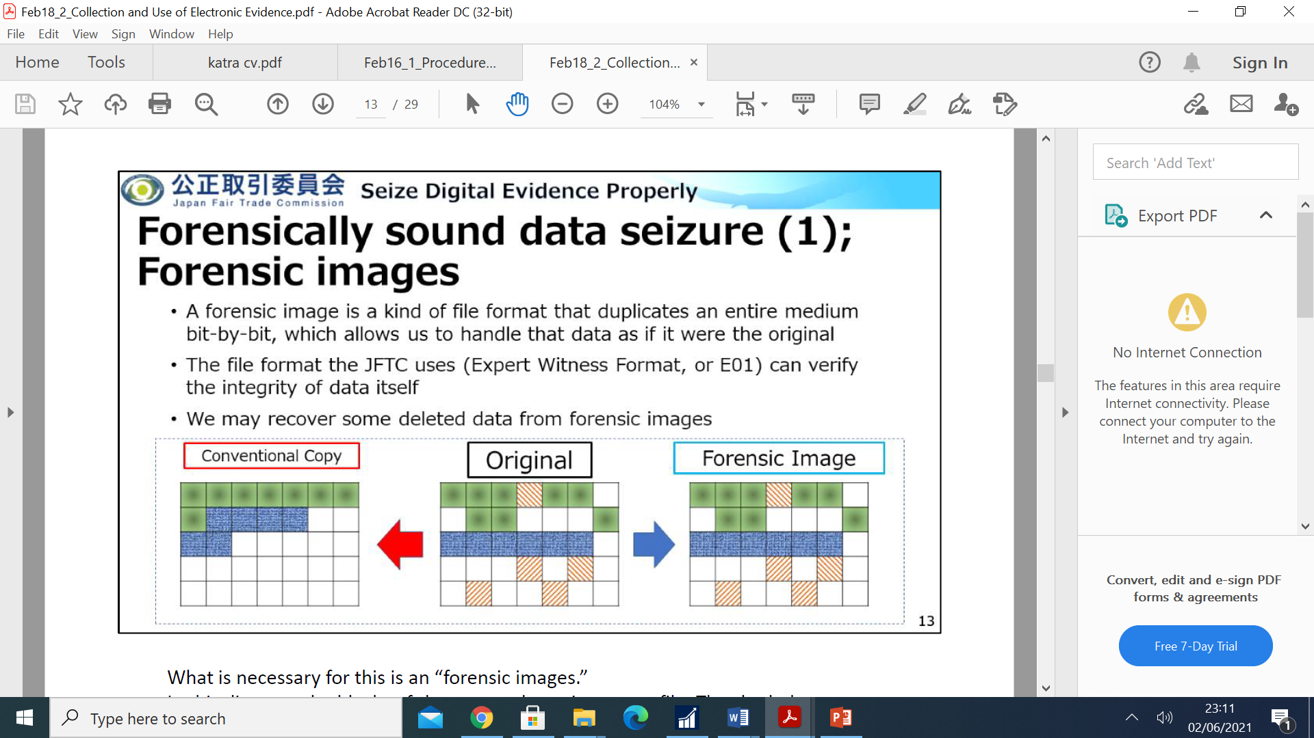
Collection and Use of Electronic Evidence Cont…
Forensically Sound data seizure
a) Forensic Images
A forensic image is a kind of file format that duplicate an entire medium bit-by-bit.
The file format the JFTC uses can verify the integrity of data itself.
JFTC may recover some deleted data from forensic images.

Slide 22
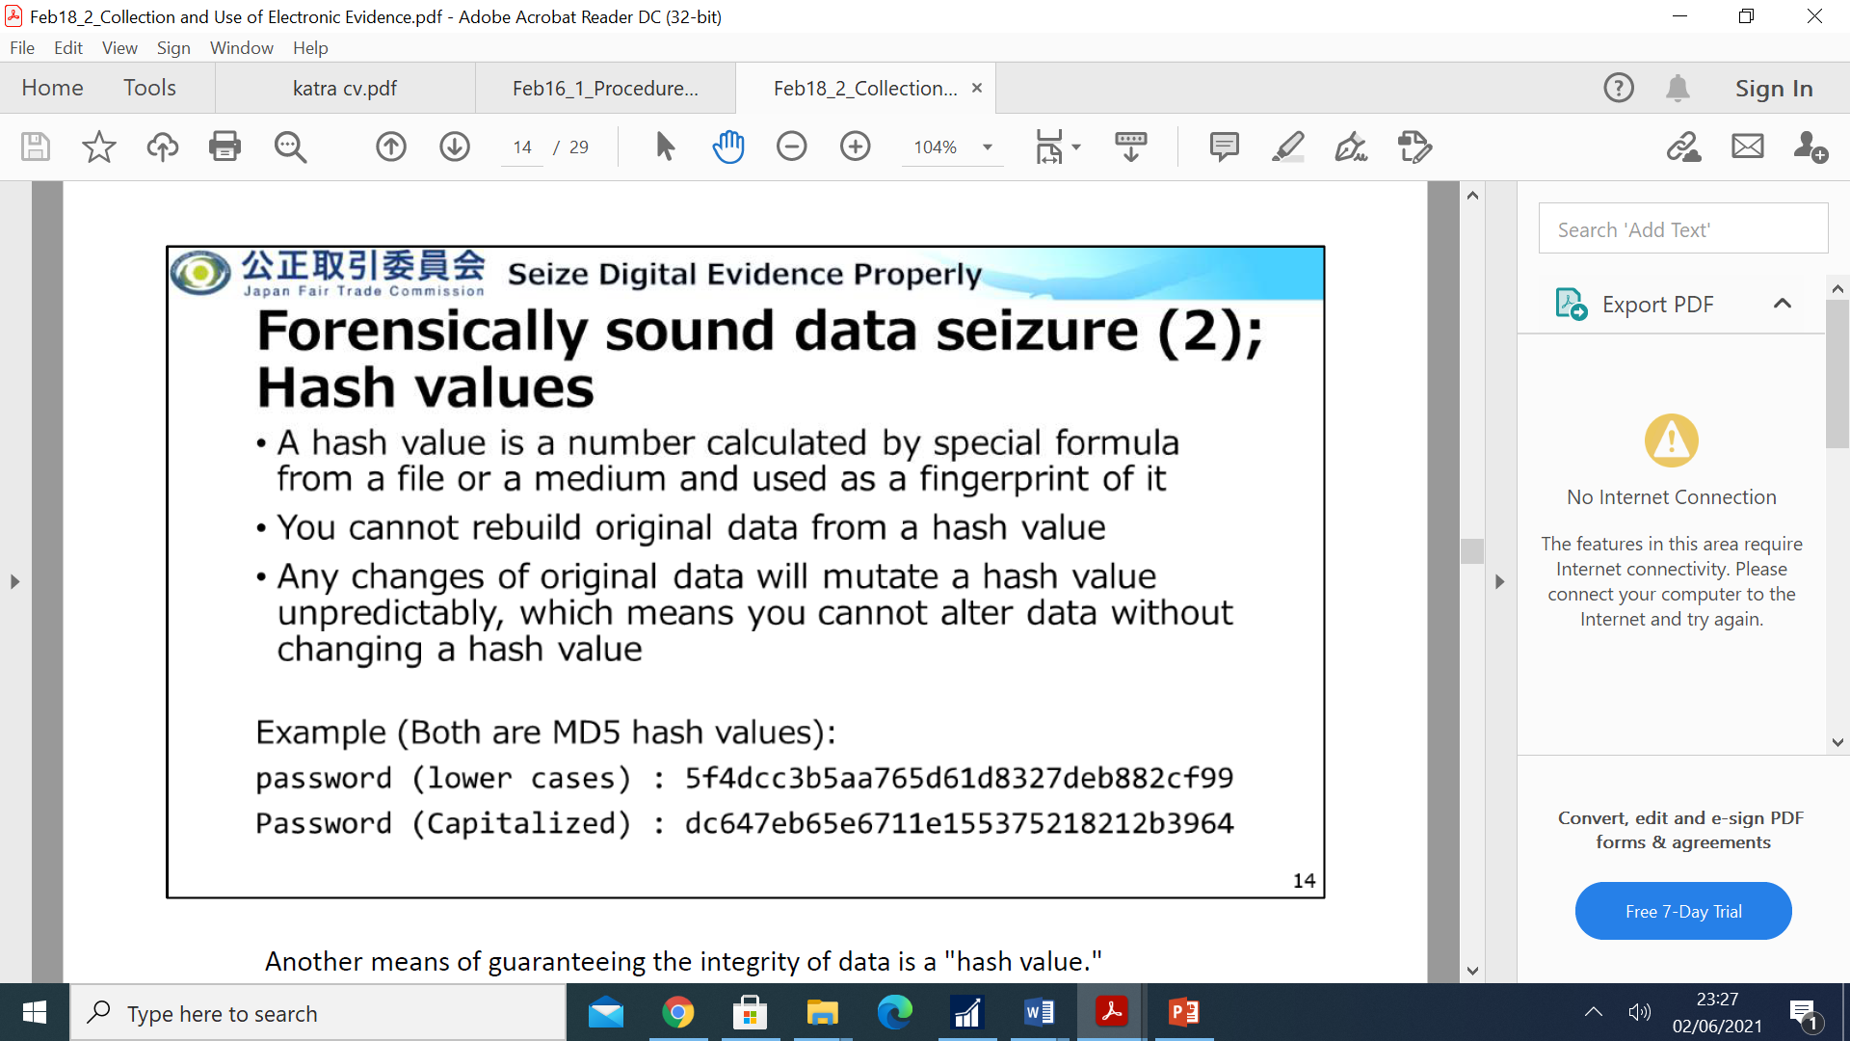
Collection and Use of Electronic Evidence Cont…
b) Hash Values
A hash values is a number calculated by special formula from a file & used as a fingerprint of it.
You cannot rebuild original data from a hash value.
Any changes of original data will mutate a hash value.

Slide 23
Collection and Use of Electronic Evidence Cont…
Software JFTC Uses in down raids
FTK Imager (free)
Can create and view forensic images.
Low chance to leave important evidence behind.
May take several hours to complete creating forensic images.
Fast Copy (free)
Can copy data with calculating hash value of each files.
Can get rid of files we usually don’t need (e.g pictures).
Cannot analyze evidence data thoroughly.

Slide 24

Collection and Use of Electronic Evidence Cont…
Documentations
You MUST write a report whenever you acquire data.
The report should capture; when it was, what device(s) you acquired (product name and serial number), which tools you used, who witnessed the procedure, how you did it, where you stored seized data and what was the result you got (names, hash values and sizes of files etc).

Slide 25

THE END

