Slide 1
KNOWLEDGE MANAGEMENT (KM)
AUDIT REPORT
FY 2020/21
Notes:
The components of knowledge management refer to the elements that knowledge management deals with to create or use knowledge in the organization.

Slide 2
The Authority, as part of its Knowledge Management (KM) initiatives, carried out an assessment of its KM activities.
The general objective of the assessment was to diagnose the current state of KM at the Authority, including obstacles and opportunities and to provide a benchmark for improvement.
The audit questionnaire was distributed to all staff of the Authority. Out of the possible seventy-six (76) respondents, forty-eight (48) responses were received representing 63% of the staff.

Slide 3
The attributes used were;
Culture;
Internal knowledge sharing;
Access to external knowledge;
Communication channel systems;
Organizational memory; and
Integration into organizational strategy.

Slide 4
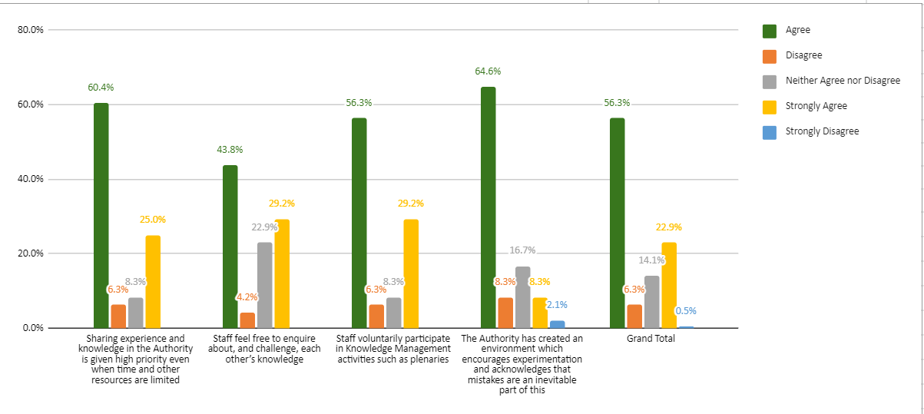
Culture

Slide 5
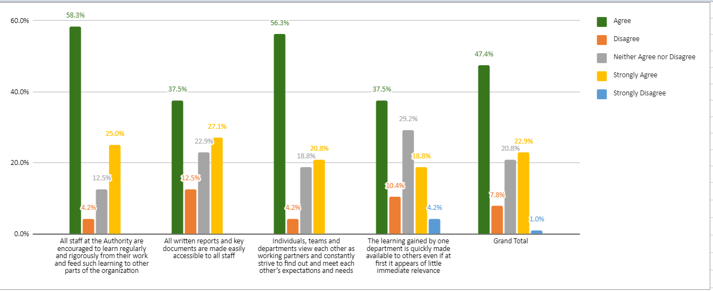
Internal Knowledge Sharing

Slide 6
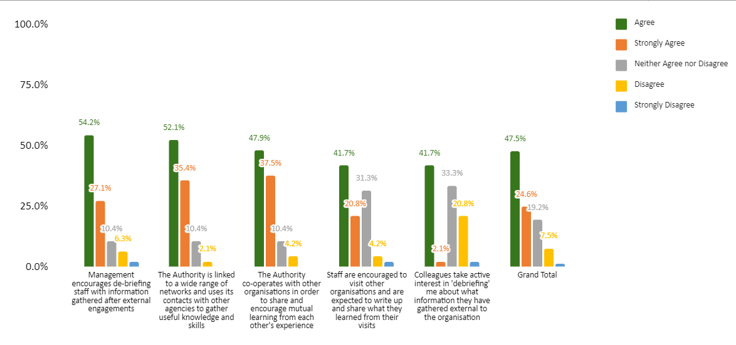
Access to external knowledge

Slide 7
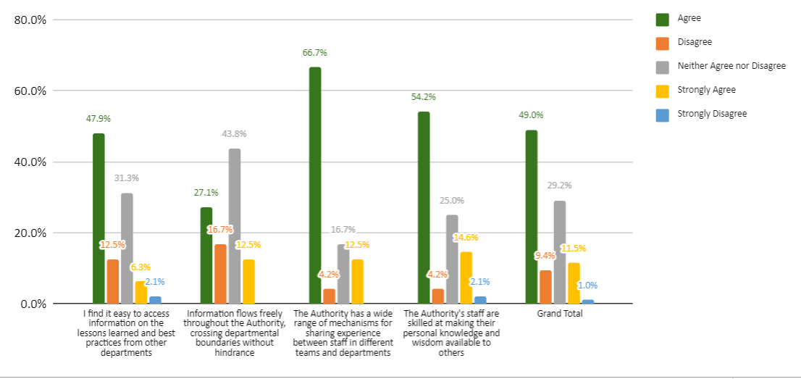
Communication channels and systems

Slide 8
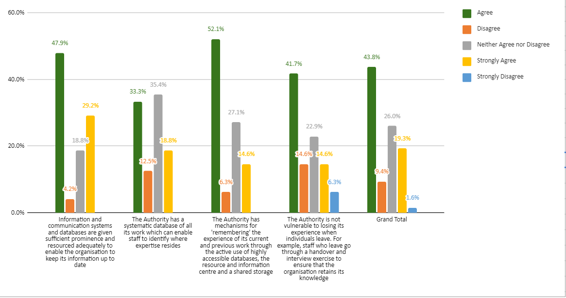
Organizational Memory

Slide 9
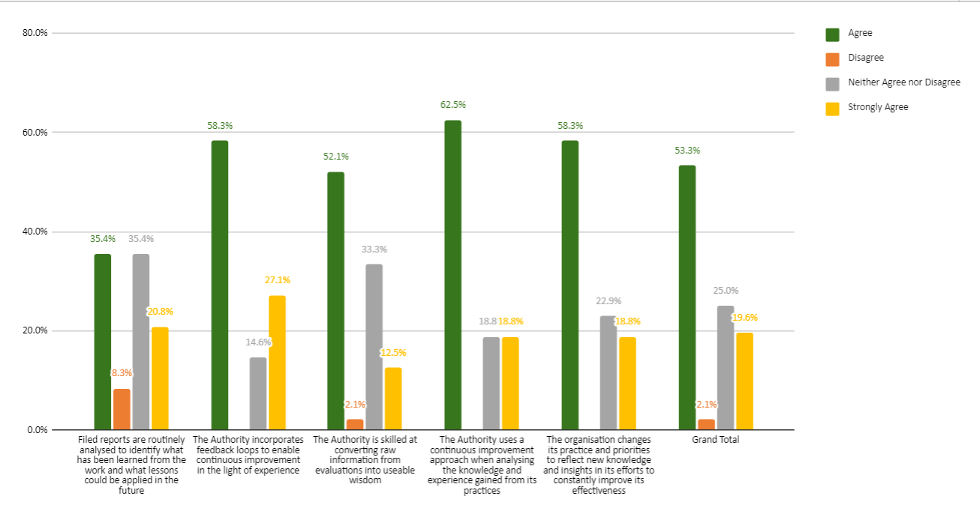
Integration of KM into organizational structure

Slide 10
Findings & Recommendations
Culture
There is a healthy knowledge culture in the Authority and staff are able to share experience, the environment created encourages experimentation, voluntary participation in knowledge management activities, and ease of inquiring and challenging each other’s knowledge on various subjects
Promote a knowledge sharing culture by creating opportunities for each staff to present their views and discuss their projects, challenges and learnings. This can be done at departmental levels.

Slide 11
Internal Knowledge Sharing
Knowledge sharing takes pace internally and staff are encouraged to learn from each other and inculcate these lessons to other parts of the organization, view each other as working partners;
Documented information is accessible and shared amongst departments as soon as necessary
Have more cross departmental forums to encourage constructive dialogue and discussions.
Digital repository

Slide 12
Access to external knowledge
There is adequate access to external knowledge. The mechanisms that enhance this include de-briefing after external engagements, networking, cooperation, collaboration trainings and workshops and exchange programs to enhance the Authority’s knowledge based from external knowledge sources.

Slide 13
Communication Channel Systems
Operationalize and create awareness of KoHa system that provides a catalogue of available information to allow easy access and ensure retention of the same for future reference
D-space
Knowledge Base-articles CMS

Slide 14
Organizational Memory
There are adequate mechanisms to aid in capturing the Authority’s organizational memory. These include the presence of a database used for storage and access to knowledge and information.
Increase/ make staff aware of existing organizational memory and avenues for documenting the same.

Slide 15
Integration of KM into organizational strategy
KM practices have been integrated into the organizational strategies as evidenced by sufficient conversion of raw information into useable data, change of practices to reflect new insights and incorporation of feedback loops
Encourage learning from failures and successes by supporting the sharing of lessons learned with others in order to support organizational strategy and policy

Slide 16


