Slide 1


Joint Venture Guidelines
COMPETITION AUTHORITY OF KENYA
"A Kenyan economy with globally efficient markets and enhanced consumer welfare for shared Prosperity"

Slide 2
Introduction
The Authority has developed various guidelines and rules in the past in consultation with the Cabinet Secretary pursuant to section 93 of the Competition Act and issued the same to stakeholders, addressing several special circumstances pertaining to competition review with respect to mergers and acquisitions.
However, these past guidelines contained minimal information on merger notification and review with regards to Full Function Joint Ventures. The increasing number of Joint Venture transactions and frequent questions regarding when and how to notify have yielded requests for improved clarity regarding their treatment under the Competition Act.

Slide 3
Definition of terms
Joint Ventures
Full Function Joint Ventures
Must perform for a long duration (10 years) all functions of an autonomous entity
Operating in the market similar to other players
Have a management dedicated to its day-to-day operations
Greenfield Joint Ventures
Integration of operation between firms
Joint Control
Substantial resource contribution from parents
Separate entity from parents
Market access
Arrangements aimed at engaging in a new business ventures
Parties to a Joint Venture – all entities entered into an agreement to engage in business activities that amount to a full function joint venture
Joint Venture Vehicle – entity incorporated for the sole purpose of undertaking the joint venture transaction

Slide 4

Filing a Notification involving Joint Ventures
  How do you identify the target and acquirer while filing?
  In absence of an existing joint Venture vehicle how do you file?
  What about in presence of an existing Joint Venture?
  Do you offer advisory opinions where it is unclear on joint venture matters?

Slide 5
Documents Required
Cover letter
MNF
Business plan
Board resolutions
Agreement
Terms of operations
Audited Financial Statement for the last 3 years
Filing fees
Business model
Justification of efficiency
Failing firm defense

Slide 6
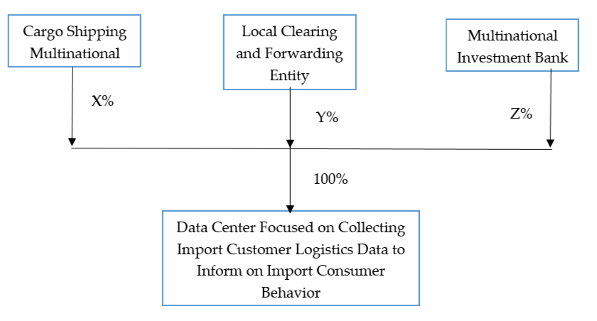
Greenfield Joint Ventures

Slide 7
Basis of Determination of Thresholds
Size of Parties Test
Turnover and assets of all parents to the JV
Turnover and assets figures for all entities controlled by parents in Kenya
Turnover and assets figures for the Joint Venture entity where applicable

Slide 8
Elements of Joint Ventures Review and Analysis
Competition review and analysis
Public interest review and analysis
Efficiencies

Slide 9

Other Issues regarding Joint Venture Transactions
Digital Economy
Remedies

Slide 10


